Slide 1
Azure Cosmos DB Monitoring and Optimization
<Speaker>
<date>

Slide 2
Agenda
Some basics concepts
RU
Monitor and detect your cosmos db
Tips and tricks
Partitioning
Modeling tips and tricks
Querying be carefull
Programming best practice

Slide 3
Azure Cosmos DB
Basics concepts

Slide 4
What are Request Units (RUs)?
In Cosmos DB, you provision the expected capacity/performance
Expressed in Request Units per second (RU/s)
Represents the "cost" of a request in terms of CPU, memory and I/O
Performance can be provisioned:
at the database-level
at the collection-level
or both
You can change RU/s programmatically with API calls or…
NEW: Autopilot (preview) to scale based on usage

Slide 5
What are Request Units (RUs)?
GET
=
Each request consumes # of RU
1 RU = 1 read of 1 KB document
10 RU = 1 read of 100 KB document
5 RU = 1 write of a 1KB document
50 RU = 1 write of a 100KB document
Query: Depends on query & documents involved
(Indexing also affects RU cost)
POST
=
PUT
=
Query
=
…

Slide 6
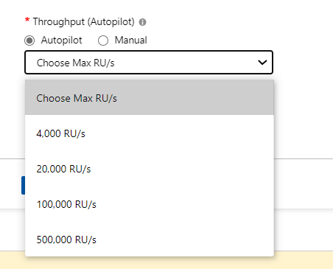
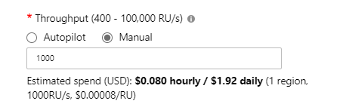
Autopilot vs manual provisioning
Autopilot (preview)
Good for bursty, unpredictable workloads
Scale between 10% and Max
Manual
Good for predictable workloads
Change RU/s programmatically with Azure function
Notes:
Preview – Can scale to 10% of

Slide 7
Understanding minimum RU/s
Minimum RU/s:
MAX(
400
Max Throughput provisioned / 100
Current storage * 10 RU/GB
)
Examples:
1 TB of storage = 1000 GB * 10 RU/GB = ? minimum
Scale up to 100,000 RU/s -> ? minimum
10,000 RU/s minimum
1000 RU/s minimum
Notes:
For import, it’s an anti-pattern to scale up extremely high and then you’re stuck with a high minimum.

Slide 8
Question
What happen to my car if I made nothing
no fuel
No maintenance
No ….
MANAGED services doesn't mean no monitoring

Slide 9
Monitoring and optimize Cosmosdb
What you can do
USE AZURE MONITOR
CHECK LOGS
USE Azure ALERTS
USE Azure ADVISORS
Setup to DO:
ENABLE MONITORING
ENABLE LOGGING
SETUP ALERT (NO ALERT BY DEFAULT)

Slide 10
Monitoring
Help to have an overview
Check 80 % of your works in 20 % of your time
Monitor the performance
Monitor the failures

Slide 11
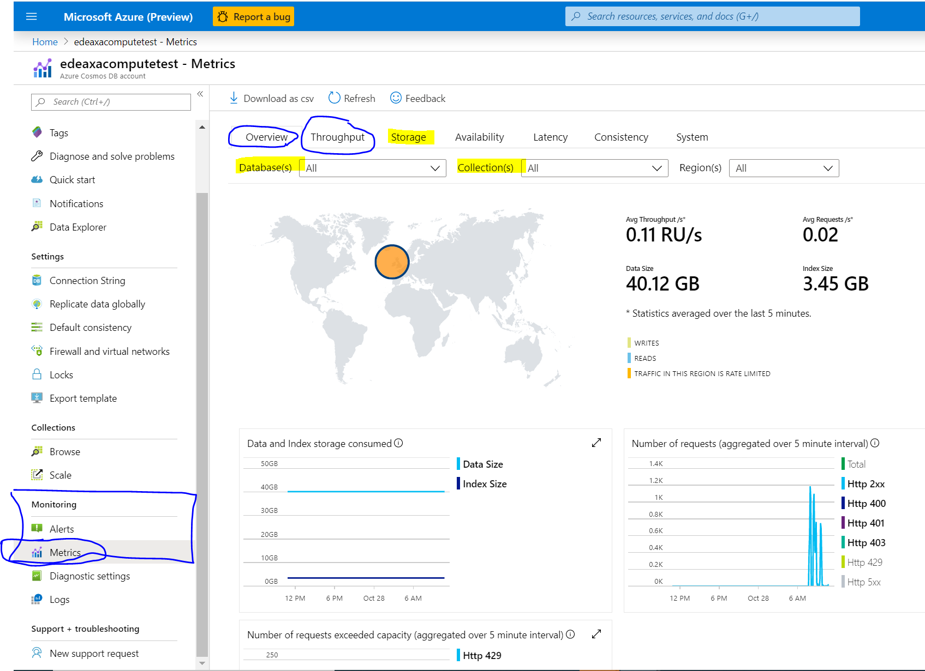
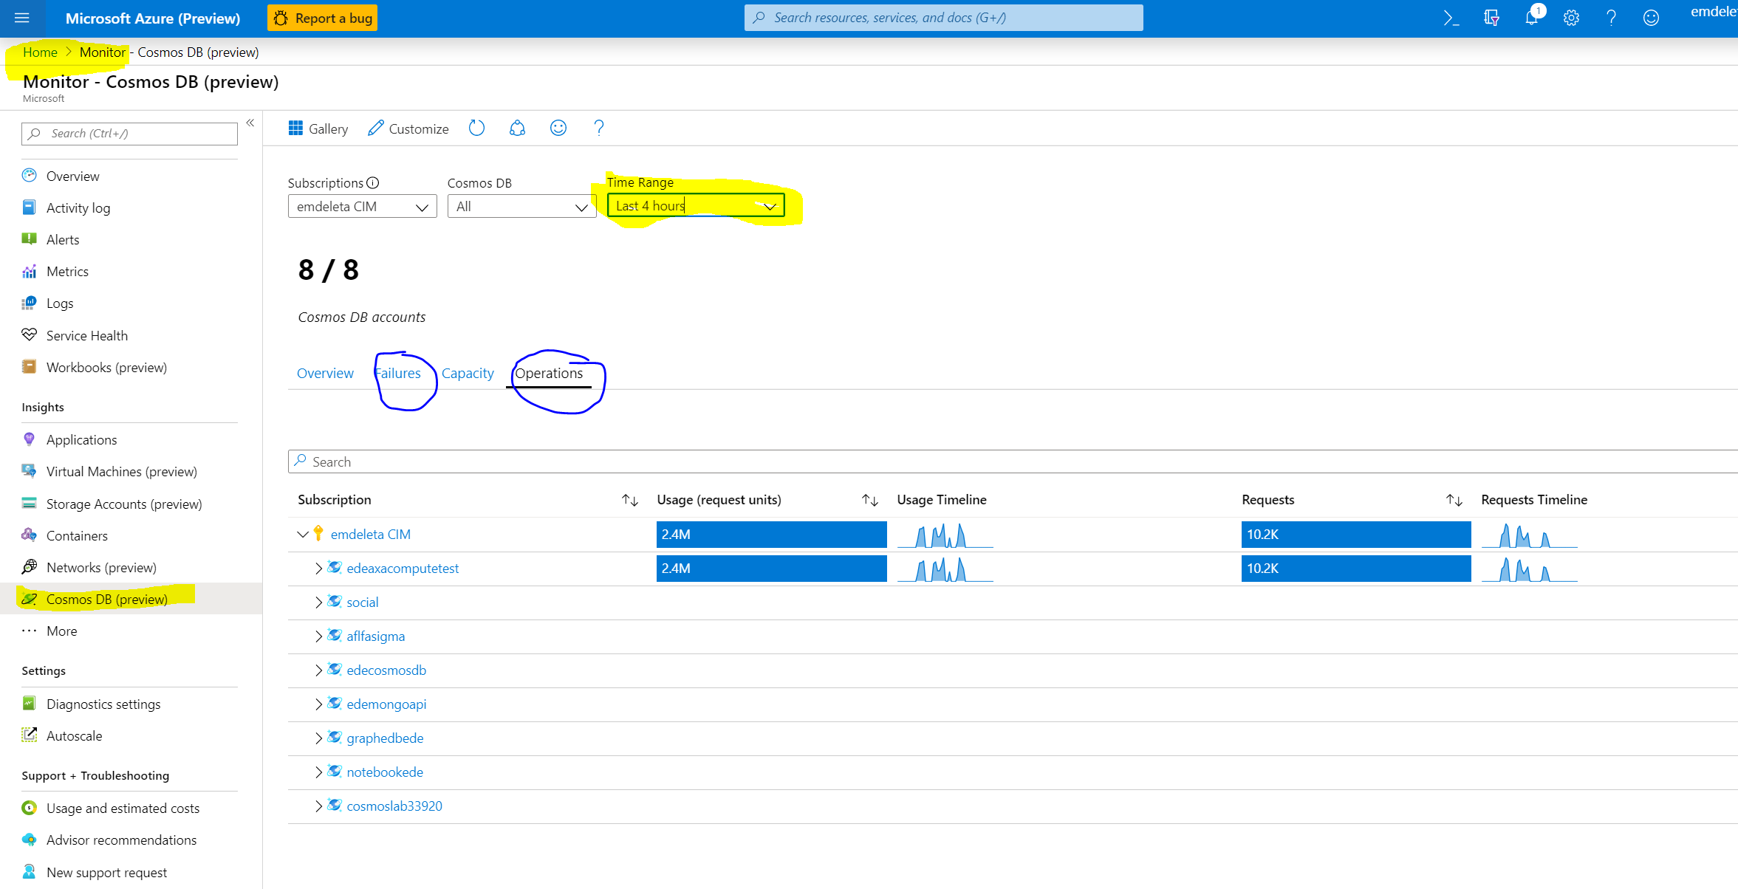
Monitor Cosmosdb
Use though Cosmosdb portal Monitoring
Use azure monitor though portal to check the overall performance
Check throughput and storage part
To check the performance and 429 error
To check the partitioning
Use though azure Monitor
Global View of all your DB
View of operations
view of capacity
View of Failures

Slide 12
LOgging
WHAT IS LOGGED BY AZURE DIAGNOSTIC LOGS
All authenticated backend requests across all protocols and APIs
Includes failed requests
Database operations
Includes CRUD operations on all resources
Account Key operations
Unauthenticated requests
Requests that result in a 401 response

Slide 13
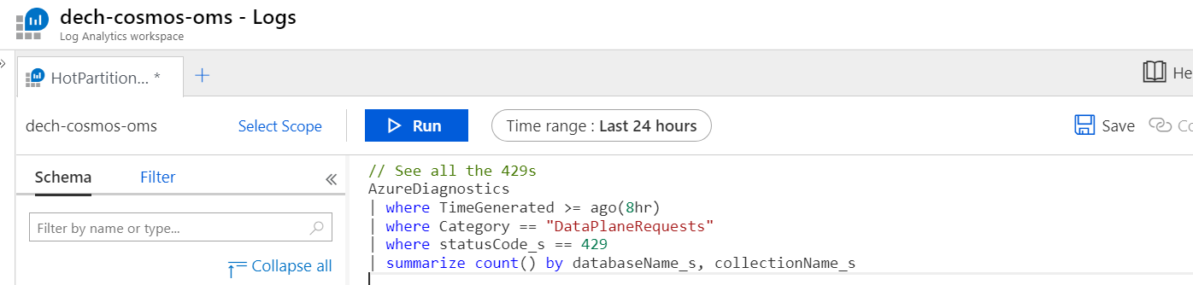
Let’s monitor with Diagnostic Logs
Cosmos DB automatically sends events to Azure Monitor, which you can view through:
Log Analytics
Event Hub
Blog storage

Slide 14
Query 1: Identifying throttles & hot partitions
// See all the 429s
AzureDiagnostics
| where TimeGenerated >= ago(8hr)
| where Category == "DataPlaneRequests"
| where statusCode_s == 429
| summarize count() by databaseName_s, collectionName_s
“Why am I getting throttled?” -> Identify resources hitting 429s

Slide 15
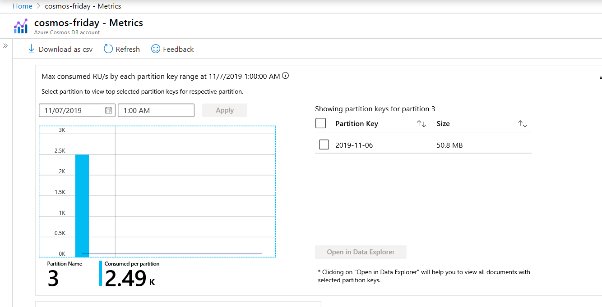
Use Cosmos DB metrics in Portal to identify hot partitions
Throughput metrics: view RU/s consumption at points in time

Slide 16
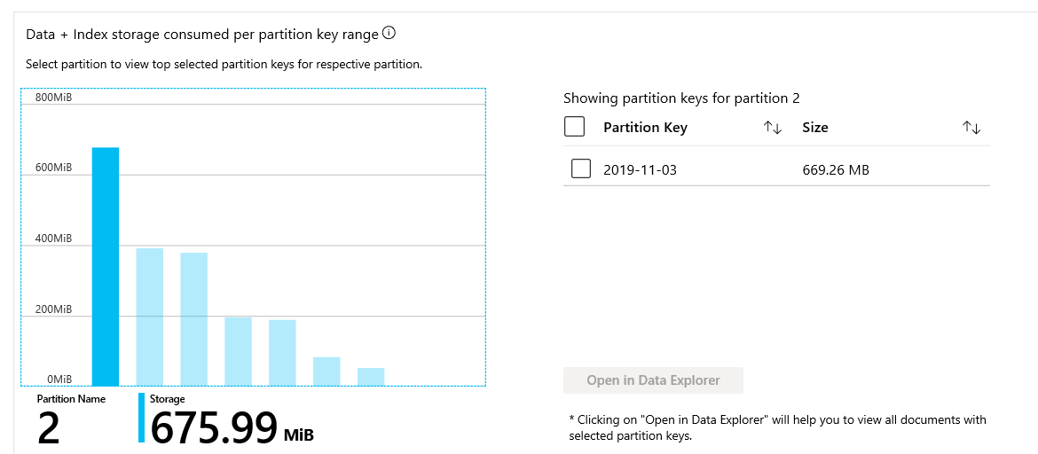
Monitor storage distribution in Metrics
Example of uneven storage distribution + partition key values on each partition

Slide 17
Query : Identifying Top RU operations
//Identify top operations and consumed RUs per operation in last 24 hours
AzureDiagnostics
| where TimeGenerated >= ago(24hr)
| where Category == "DataPlaneRequests"
| summarize numberOfOperations = count(), totalConsumedRU = sum(todouble(requestCharge_s)) by Resource, databaseName_s, collectionName_s, OperationName, requestResourceType_s, requestResourceId_s
| extend averageRUPerOperation = totalConsumedRU / numberOfOperations
| order by numberOfOperations
“Why am I getting throttled?” -> Which operations are causing 429s?

Slide 18
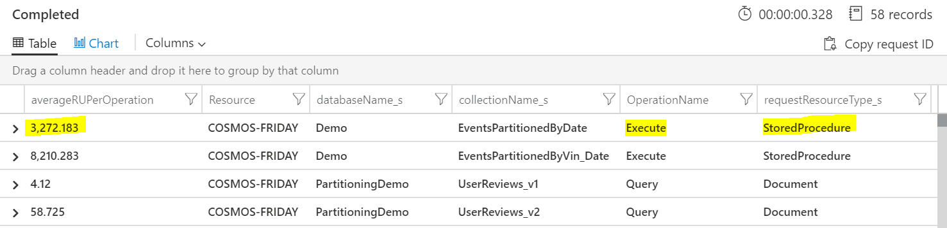
Understanding 429s
If 429s are happening on bulk import operations – that’s (usually) ok!

Slide 19
Query 3: Identifying Top RU consuming queries
AzureDiagnostics
| where ResourceProvider=="MICROSOFT.DOCUMENTDB" and Category=="DataPlaneRequests" and todouble(requestCharge_s) > 100.0
| project activityId_g, requestCharge_s
| extend activityId = tostring(activityId_g)
| join kind= inner (
AzureDiagnostics
| where ResourceProvider =="MICROSOFT.DOCUMENTDB" and Category == "QueryRuntimeStatistics"
| project activityId_g, querytext_s
) on $left.activityId_g == $right.activityId_g
| order by requestCharge_s desc
| limit 100

Slide 20
GBB Note: “Why is Cosmos DB so expensive?”
Try to see if there are collections that are overprovisioned
Query gives you RU/s per a collection
AzureDiagnostics
| where TimeGenerated >= ago(1hr)
| where Category == "DataPlaneRequests"
| where collectionName_s == "UserReviews_v1"
| summarize ConsumedRUsPerSecond = sum(todouble(requestCharge_s)) by collectionName_s, bin(TimeGenerated, 1sec)
| project TimeGenerated , ConsumedRUsPerSecond , collectionName_s

Slide 21
Other Magic requestS
All the event in Cosmosdb by categories
AzureDiagnostics | where ResourceProvider=="MICROSOFT.DOCUMENTDB" | summarize count () by Category
Add the type category == «»
AzureDiagnostics | where ResourceProvider=="MICROSOFT.DOCUMENTDB" and Category=="DataPlaneRequests" | take 10
Order or sort by duration_s and requestCharge_s ( time and cost ) AzureDiagnostics | where ResourceProvider=="MICROSOFT.DOCUMENTDB" and Category == "MongoRequests" | sort by todouble(requestCharge_s) desc AzureDiagnostics | where ResourceProvider=="MICROSOFT.DOCUMENTDB" and Category == "MongoRequests" | sort by todouble(duration_s) desc
Filter on your data ( databaseName_s ) To find the costly request
AzureDiagnostics | where todouble(requestCharge_s) > 1 and databaseName_s == "RCS" | sort by todouble(requestCharge_s) desc
To show information AzureDiagnostics | where ResourceProvider=="MICROSOFT.DOCUMENTDB" and Category=="MongoRequests" | project TimeGenerated , todouble(duration_s) | render timechart

Slide 22
ALERTING
Setup alert to automate administrative task :
Alert on change
Alert on most popular error :
429 Too Many Request
413 Entity Too Large
400 Bad Request ….. https://docs.microsoft.com/en-us/rest/api/cosmos-db/http-status-codes-for-cosmosdb
Add any action
Email
Azure fonction can be add ( all you want by code ) (autoscale ? )

Slide 23
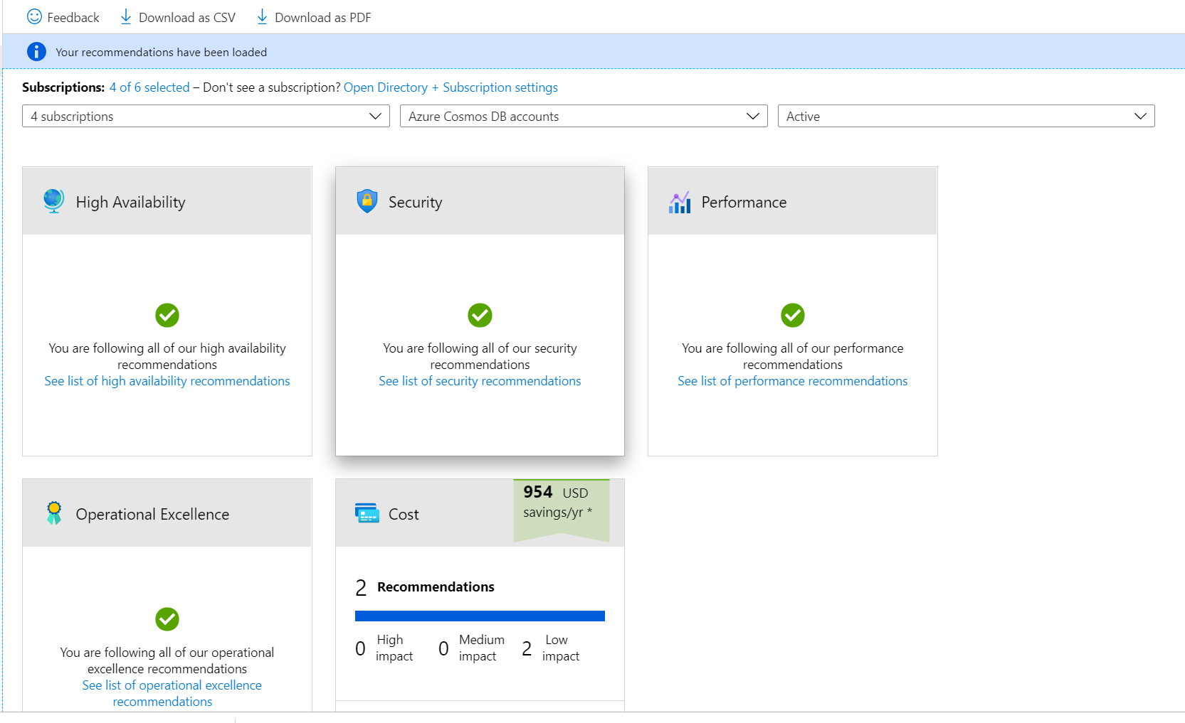
ADVISORS
Azure Advisors can help you to check on Cosmosdb

Slide 24
Azure Cosmos DB
Optimize your CosmosDB

Slide 25
Optimize
Optimization is not a one-shot task
Optimization depend on the need
Performance
Cost
Need to find a balance
Not think like RDBMS DATABASE
Not only DBA should made optimization
A Database is a Database (cardinality, no magic)

Slide 26
Azure Cosmos DB
Some mandatory concept

Slide 27
Database Level Throughput
You can provision throughput at the database level instead of individually for each container
Throughput is shared among each designated container within the database
You can provision dedicated throughput for some containers
Notes:
We want to avoid throttling (rate limiting)

Slide 28
Database vs Container Level Throughput
In general, container level throughput is a good choice. This leads to predictable performance since each container is guaranteed its provisioned RU’s
Choosing Database Level Throughput can also be a good option if:
You are migrating many containers in a lift and shift migration (from Table Storage, MongoDB, or Cassandra) and does not know how much throughput to set for each one
You have containers that are timeshared
Multitenant applications where each user is represented by a separate container
Notes:
We want to avoid throttling (rate limiting)

Slide 29
Cosmos DB reserved Capacity can provide up to 65% savings
Save up to 65% with Azure Cosmos DB reserved capacity pricing
+ Up to 65% savings
Customer cost
Best value for the price
Best elasticity for the price
Saturation of provisioned capacity via sub-core multiplexing
Deep integration w/ Azure Networking
No need to segment
into read and write workloads –
w/ unified and normalized throughput currency - RUs
Total Time To Live (TTL) is free
Enterprise-ready (security, compliance, encryption) at no additional cost

Slide 30
Why is this query consuming a lot of Rus or take time ?

Slide 31
PARTITIONING Already cover

Slide 32
Data modelling
Cosmos DB != relational database
Write out the data access patterns….
Then choose the partition key and data model ☺

Slide 33
Mixing entity types
Leverage the schema-agnostic nature of Cosmos DB
Suitable when different entity types
share similar access patterns
are queried by the same partition key
are queried together (for JOIN-like capabilities)
Typical implementation is to add a "type" property to discriminate different types

Slide 34
Reference vs. embed
Embedding
Referencing
{
"id": "<post-id>",
"title": "<post-title>",
"content": "<post-content>",
"comments": [
{
"id": "<comment-id-1>",
"content": "…"
},
{
"id": "<comment-id-2>",
"content": "…"
}
]
}
{
"id": "<post-id>",
"title": "<post-title>",
"content": "<post-content>"
}
{
"id": "<comment-id-1>",
"postId": "<post-id>",
"content": "…"
}
{
"id": "<comment-id-2>",
"postId": "<post-id>",
"content": "…"
}

Slide 35
Reference vs. embed
Embed when:
1:1
1:few
Items queried together
Items updated together
Reference when:
1:many (unbounded)
Many:many
Items updated independently

Slide 36
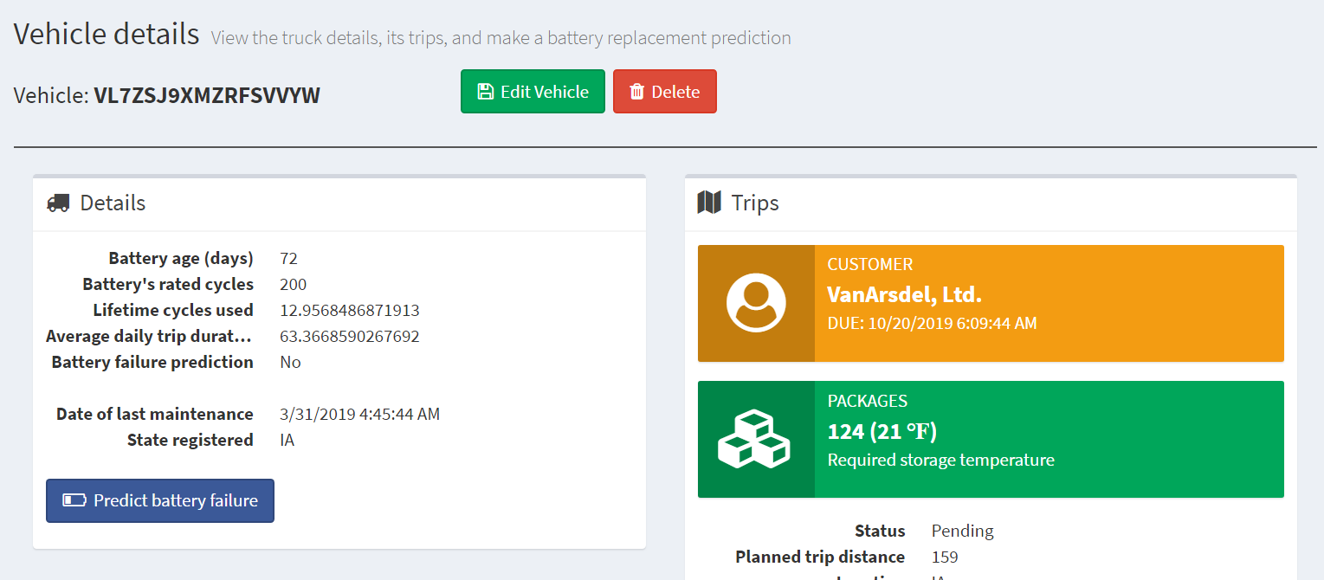
Our scenario: Embed vs. reference
Trip – has multiple packages
Package – details about each package

Slide 37
Trip entity
Package entity
[{
"id": "e2c7ca5e-2ef1-4ac2-836d-74124811516c",
"partitionKey": "DB2JXBWBLCL09FJFU",
"entityType": "Trip",
"vin": "DB2JXBWBLCL09FJFU",
"consignmentId": "1f145aad-d943-44c7-b0f3-1bc8562c7628",
"plannedTripDistance": 190.53,
"location": "OR",
…
"status": "Pending",
"timestamp": "0001-01-01T00:00:00",
"packages": [
{
"packageId": "514edbdc-210b-45f8-b05f-d491d6ded7e4",
"storageTemperature": 22,
"highValue": false
},
……
{
"packageId": "26128844-cc3f-4808-99f7-2b142ad002e5",
"storageTemperature": 32,
"highValue": false
}
],
"consignment": {
"consignmentId": "1f145aad-d943-44c7-b0f3-1bc8562c7628",
"customer": "Bellows College",
"deliveryDueDate": "2019-10-20T05:56:44.7367547Z"
}]
[{
"id": "ad476b94-8b3a-4ab8-ba5f-b95ad75acd63",
“packageId": " 26128844-cc3f-4808-99f7-2b142ad002e5",
"partitionKey": " 26128844-cc3f-4808-99f7-2b142ad002e5",
"entityType": "Package",
"tripId": "ed96feb9-957e-4d30-873e-7a4f12266022",
"consignmentId": "cb56399c-65b3-452b-89f0-d3b9bed5fa02",
"height": 33.37,
"length": 41.45,
"width": 20.96,
"grossWeight": 223.72,
"storageTemperature": 39,
"highValue": false,
"trip": {
"tripId": "ed96feb9-957e-4d30-873e-7a4f12266022",
"vin": "AESQX3ZKCFM25HNNE",
"plannedTripDistance": 137.09
},
"consignment": {
"consignmentId": "cb56399c-65b3-452b-89f0-d3b9bed5fa02",
"customer": "Lamna Healthcare Company",
"deliveryDueDate": "2019-10-20T08:26:44.7366267Z"
},
"timestamp": "0001-01-01T00:00:00",
}]
Select package info makes it easier to generate Trip summary info view

Slide 38


Customers often have this reaction
Separate containers for different entities “feels” cleaner, but doesn’t really leverage NoSQL schema flexibility.
Mix different entity types for data that is related in same workload
Encourage customer: this is a best practice!

Slide 39
Query Tuning
Some important Cosmos DB query performance factors include:
Provisioned throughput
Measure RU per query, and ensure that you have the required provisioned throughput for your queries
Partitioning and partition keys
Favor queries with the partition key value in the filter clause for low latency
SDK and query options
Follow SDK best practices like direct connectivity, and tune client-side query execution options
Network latency
Account for network overhead in measurement, and use multi-homing APIs to read from the nearest region

Slide 40
Query Tuning
Additional important Cosmos DB query performance factors include:
Indexing Policy
Ensure that you have the required indexing paths/policy for the query
Query Complexity
Use simple queries to enable greater scale.
Query execution metrics
Analyze the query execution metrics to identify potential rewrites of query and data shapes
Notes:
Query Complexity: avoid using complex queries (such as MongoDB aggregation pipeline) whenever simpler queries are possible (such as find/SELECT with filter condition). Simpler queries scale much better.

Slide 41
Handle any data with no schema or indexing required
Azure Cosmos DB’s schema-less service automatically indexes all your data, regardless of the data model, to delivery blazing fast queries.
Automatic index management
Synchronous auto-indexing
No schemas or secondary indices needed
Works across every data model
GEEK
Item | Color | Microwave safe | Liquid capacity | CPU | Memory | Storage
Geek mug | Graphite | Yes | 16ox | ??? | ??? | ???
Coffee Bean mug | Tan | No | 12oz | ??? | ??? | ???
Surface book | Gray | ??? | ??? | 3.4 GHz Intel Skylake Core i7-6600U | 16GB | 1 TB SSD
Notes:
At global scale, schema/index management is hard
Automatic and synchronous indexing of all ingested content - hash, range, geo-spatial, and columnar
No need to define schemas or secondary indices upfront
Resource governed, write optimized database engine with latch free and log structured techniques
Online and in-situ index transformations

Slide 42
INDEXING JSON Documents
{
"locations": [
{
"country": "Germany",
"city": "Bonn",
"revenue": 200
}
],
"headquarter": "Italy",
"exports": [
{
"city": "Berlin",
"dealers": [
{ "name": "Hans" }
]
},
{ "city": "Athens" }
]
}
locations
headquarter
exports
0
Italy
0
1
country
city
revenue
city
dealers
city
Germany
Bonn
200
Berlin
0
name
Hans

Slide 43
Index POLICIES
CUSTOM INDEXING POLICIES
Though all Azure Cosmos DB data is indexed by default, you can specify a custom indexing policy for your collections. Custom indexing policies allow you to design and customize the shape of your index while maintaining schema flexibility.
Define trade-offs between storage, write and query performance, and query consistency
Include or exclude documents and paths to and from the index
Configure various index types
{
"automatic": true,
"indexingMode": "Consistent",
"includedPaths": [{
"path": "/*",
"indexes": [{
"kind": "Hash",
"dataType": "String",
"precision": -1
}, {
"kind": "Range",
"dataType": "Number",
"precision": -1
}, {
"kind": "Spatial",
"dataType": "Point"
}]
}],
"excludedPaths": [{
"path": "/nonIndexedContent/*"
}]
}
Notes:
Include or exclude documents and paths to and from the index
You can exclude or include specific documents in the index when you insert or replace the documents in the collection. You can also include or exclude specific JSON properties, also called paths, to be indexed across documents that are included in an index. Paths include wildcard patterns.
Configure various index types
For each included path, you can specify the type of index the path requires for a collection. You can specify the type of index based on the path's data, the expected query workload, and numeric/string “precision.”
Configure index update modes
Azure Cosmos DB supports three indexing modes: Consistent, Lazy, and None. You can configure the indexing modes via the indexing policy on an Azure Cosmos DB collection.

Slide 44
Indexing Policy
{
"indexingMode": "consistent",
"automatic": true,
"includedPaths": [
{
"path": "/age/?",
"indexes": [
{
"kind": "Range",
"dataType": "Number",
"precision": -1
},
]
},
{
"path": "/gender/?",
"indexes": [
{
"kind": "Range",
"dataType": "String",
"precision": -1
},
]
}
],
"excludedPaths": [
{
"path": "/*"
}
]
}
{
"indexingMode": "none",
"automatic": false,
"includedPaths": [],
"excludedPaths": []
}
No indexing
Index some properties

Slide 45
Composite Indexes
These must be added and are needed for queries that ORDER BY two or more properties.
ORDER BY queries on multiple properties:
SELECT * FROM container c ORDER BY c.firstName, c.lastName

Slide 46
Online Index Transformations
On-the-fly Index Changes
In Azure Cosmos DB, you can make changes to the indexing policy of a collection on the fly. Changes can affect the shape of the index, including paths, precision values, and its consistency model.
A change in indexing policy effectively requires a transformation of the old index into a new index.
v1 Policy
v2 Policy
New document writes (CRUD) & queries
t₀
t₁
PUT /colls/examplecollection { indexingPolicy: … }
GET /colls/examplecollection x-ms-index-transformation-progress: 100
Notes:
Index transformations are made online. This means that the documents indexed per the old policy are efficiently transformed per the new policy without affecting the write availability or the provisioned throughput of the collection. The consistency of read and write operations made by using the REST API, SDKs, or from within stored procedures and triggers is not affected during index transformation. There's no performance degradation or downtime to your apps when you make an indexing policy change.

Slide 47
Index Tuning
Metrics Analysis
The SQL APIs provide information about performance metrics, such as the index storage used and the throughput cost (request units) for every operation. You can use this information to compare various indexing policies, and for performance tuning.
When running a HEAD or GET request against a collection resource, the x-ms-request-quota and the x-ms-request-usage headers provide the storage quota and usage of the collection.
You can use this information to compare various indexing policies, and for performance tuning.
Update Index Policy
View Headers
Query Collection
Index
Collection
Notes:
Update index policy
Query collection
View Results
Repeat Step 1

Slide 48
Best Practices
By default is good but not best
Understand query patterns – which properties are being used?
Understand impact on write cost – index update RU cost scales with # properties

Slide 49
SDK – client side tips & tricks
Use singleton instance of CosmosClient
Use direct mode (default for V3)
Set ApplicationRegion (or PreferredLocations)
Use point reads (key value lookups)
Tune page size
Tune max degree of parallelism
Use Stream API – if applicable

Slide 50
Client Query Parallelism
CROSS-PARTITOIN QUERIES CAN BE PARRALELIZED TO USE AS MANY THREADS AS POSSIBLE
Modern processors ship with both physical and virtual (hyper-threading) cores. For any given cross-partition query, the SDK can use concurrent threads to issue the query across the underlying partitions.
By default, the SDK uses a slow start algorithm for cross-partition queries, increasing the amount of threads over time. This increase is exponential up to any physical or network limitations.
Primary Thread
Concurrent Thread
DOP = 4
Concurrent Thread
Query Thread
DOP = 1
Concurrent Thread

Slide 51
Client REsponse Buffer
2
First Request
1
3
First Response
6
4
Concurrent Request
5
Client Buffer
Concurrent Response
Notes:
The client device’s code using an SDK to issue a request
The SDK issues the first request for query results to the Azure Cosmos DB service
The Azure Cosmos DB service returns the first set of results to be processed by the client (serialization, etc)
While the client is processing the first set of results, a concurrent request is sent to pre-fetch additional results
The items returned as a response of the current request are then stored in a client-side buffer
Buffered items are processed by the client SDK

Slide 52
SDK Query Options
ACHIEVING OPTIMAL PERFORMANCE IS OFTEN A BALANCING ACT BETWEEN THESE TWO PROPERTIES
Decreased Thread Usage
Slower Performance
Increased Thread Usage
Faster Performance
0
Max Degree of Parallelism
∞
Smaller Memory Footprint
Slower Performance
Larger Memory Footprint
Faster Performance
0
Max Buffered Item Count
∞

Slide 53
SDK Query Options
Setting | Value | Effect
MaxDegreeofParallelism | -1 | The system will automatically decide the number of items to buffer
 | 0 | Do not add any additional concurrent threads
 | >= 1 | Add the specified number of additional concurrent threads
MaxBufferedItemCount | -1 | The system will automatically decide the number of concurrent operations to run
 | 0 | Do not maintain a client-side buffer
 | >= 1 | Specify the maximum size (items) of the client-side buffer

Slide 54
Measuring RU CHARGE
ANALYZE QUERY COMPLEXITY
The complexity of a query impacts how many Request Units are consumed for an operation. The number of predicates, nature of the predicates, number of system functions, and the number of index matches / query results all influence the cost of query operations.
MEASURE QUERY COST
To measure the cost of any operation (create, update, or delete):
Inspect the x-ms-request-charge header
Inspect the RequestCharge property in ResourceResponse or FeedResponse in the SDK
NUMBER OF INDEXED TERMS IMPACTS WRITE RU CHARGES
Every write operation will require the indexer to run. The more indexed terms you have, the more indexing will be directly having an effect on the RU charge.
You can optimize for this by fine-tuning your index policy to include only fields and/or paths certain to be used in queries.

Slide 55
Measuring RU CHARGE
STABILIZED LOGICAL CHARGES
Azure Cosmos DB uses information about past runs to produce a stable logical charge for the majority of CRUD or query operations.
Since this stable charge exists, we can rely on our operations having a high degree of predictability with very little variation. We can use the predictable RU charges for future capacity planning.
BULK OF QUERY RU CHARGES IS IO
Query RU is directly proportional to the quantity of query results.
Notes:
Azure Cosmos DB uses ML to produce a stable logical charge for vast majority of operations (CRUD and query). This gives a high degree of predictability for capacity planning (if creating document X costs 5 RU’s today, we can rely on the fact that it will cost 5 RU’s tomorrow). This isolates RU charge from variability in physical resource utilization due to other noisy processes like garbage collection

Slide 56
Other TIPS and TRICKS

Slide 57
Containers
CONTAINERS
Containers do NOT enforce schema
There are benefits to co-locate multiple types in a container
Annotate records with a "type" property
CO-LOCATING TYPES IN THE SAME CONTAINER
Ability to query across multiple entity types with a single network request.
Ability to perform transactions across multiple types
Cost: reduce physical partition footprint

Slide 58
Short-Lifetime Data
Some data produced by applications are only useful for a finite period of time:
Machine-generated event data
Application log data
User session information
It is important that the database system systematically purges this data at pre-configured intervals.

Slide 59
Time-to-Live (TTL)
AUTOMATICALLY PURGE DATA
Azure Cosmos DB allows you to set the length of time in which documents live in the database before being automatically purged. A document's "time-to-live" (TTL) is measured in seconds from the last modification and can be set at the collection level with override on a per-document basis.
The TTL value is specified in the _ts field which exists on every document.
The _ts field is a unix-style epoch timestamp representing the date and time. The _ts field is updated every time a document is modified.
Once TTL is set, Azure Cosmos DB will automatically remove documents that exist after that period of time.

Slide 60
Expiring Records Using Time-to-Live
TTL BEHAVIOR
The TTL feature is controlled by TTL properties at two levels - the collection level and the document level.
DefaultTTL for the collection
If missing (or set to null), documents are not deleted automatically.
If present and the value is "-1" = infinite – documents don’t expire by default
If present and the value is some number ("n") – documents expire "n” seconds after last modification
TTL for the documents:
Property is applicable only if DefaultTTL is present for the parent collection.
Overrides the DefaultTTL value for the parent collection.
The values are set in seconds and are treated as a delta from the _ts that the document was last modified at.
Document
Document
TTL
Default TTL
Collection
Notes:
As soon as the document has expired (ttl + _ts <= current server time), the document is marked as "expired”. No operation will be allowed on these documents after this time and they will be excluded from the results of any queries performed.
The documents are physically deleted in the system, and are deleted in the background opportunistically at a later time.
This does not consume any Request Units (RUs) from the collection budget.

Slide 61
TO Resume and my PERSONAL advice
Enable monitoring when you create the endpoint
Cassandra API, MongoDB API are wrapper, if you start a new project use the SQL API
Think at model, organization
RU / partition
RU / DB
usually optimum should be a mix
Partition Key is the key
Avoid default index policy
Think Cloud (everything can run but think from the start that you pay what you consume (data, CPU, IOPS))
Monitor (DBA is not a “LUXE”)
Notes:
Azure Cosmos DB uses ML to produce a stable logical charge for vast majority of operations (CRUD and query). This gives a high degree of predictability for capacity planning (if creating document X costs 5 RU’s today, we can rely on the fact that it will cost 5 RU’s tomorrow). This isolates RU charge from variability in physical resource utilization due to other noisy processes like garbage collection

Slide 62
Other information

Slide 63
Response Status Codes
Code | Meaning
200 OK | GET, PUT or POST operation was successful
201 Created | Resource created successfully using a POST operation
204 No Content | Resource deleted successfully using a DELETE operation
401 Unauthorized | Invalid Authorization header
403 Forbidden | Authorization token expired Resource quota reached when attempting to create a document Stored Procedure, Trigger or UDF is blacklisted from executed
409 Request Timeout | Stored Procedure, Trigger or UDF exceeded maximum execution time

Slide 64
Response Status Codes
Header | Value
409 Conflict | The item Id for a PUT or POST operation conflicts with an existing item
412 Precondition Failure | The specified eTag is different from the version on the server (optimistic concurrency error)
413 Entity Too Large | The item size exceeds maximum allowable document size of 2MB
429 Too Many Requests | Container has exceeded provisioned throughput limit
449 Retry With | Transient error has occurred, safe to retry
50x | Server-side error. If effort persists, contact support

Slide 65
Response Headers
Header | Value
x-ms-activity-id | Unique identifier for the operation
x-ms-serviceversion | Service Version used for request/response
x-ms-schemaversion | Schema Version used for request/response
x-ms-item-count | In a query (or read-feed), the number of items returned
x-ms-alt-content-path | REST URI to access resource using user-supplied IDs
etag | The same value as the _etag property of the requested item

Slide 66
Response Headers
Header | Value
x-ms-continuation | Token returned if a query (or read-feed) has more results and is resubmitted by clients as a request header to resume execution
x-ms-session-token | Used to maintain session consistency. Clients much echo this as a request header in subsequent operations to the same container
x-ms-request-charge | Number of normalized RU/s for the operation
x-ms-resource-quota | Allotted quota for the specified resource in the account
x-ms-resource-usage | Current usage count of the specified resource in the account
x-ms-retry-after-ms | If rate limited, the number of milliseconds to wait before retrying the operation
Notes:
Per Andrew, need to include “intro the standard HTTP response code convention of 2xx is success, 4xx is client error, 5xx is server error.”

